Slide 1



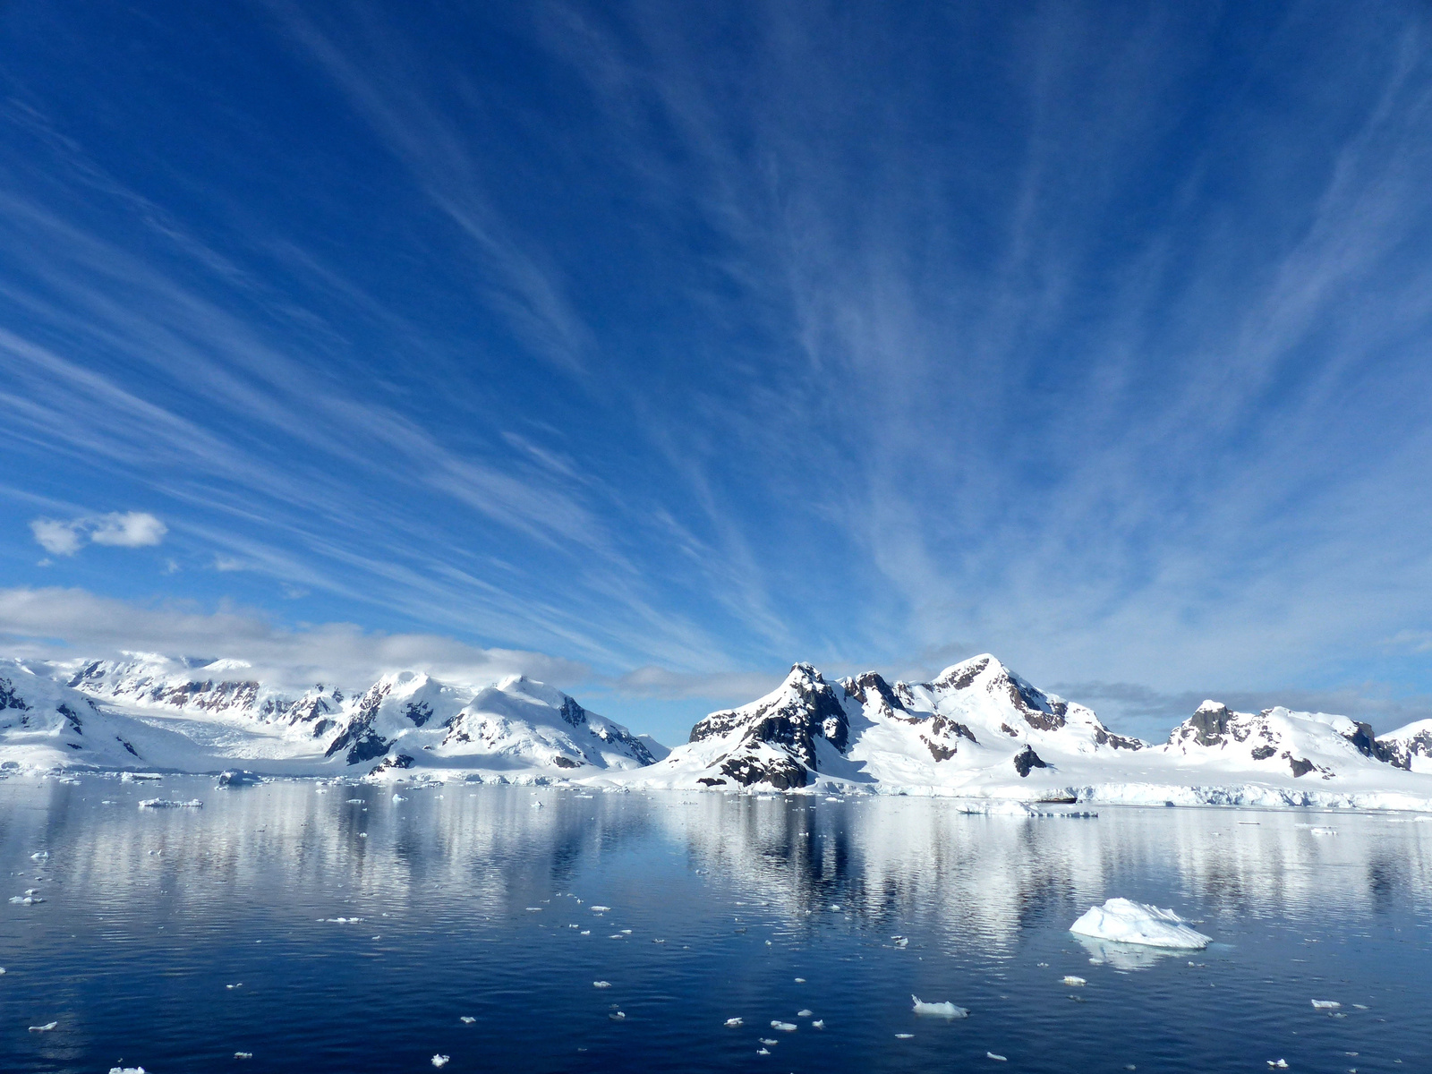


www、、.reallygreatsite.com
Alpha Generation
by machine learning
Muya Liu
Xuan Liu
Xinyue Cao

Slide 2
Returns
Introduction
2.1 Return
Fama French Five-Factor Model
Expected Returns
Parameter Optimization
α
Elastic net
Ridge
Lightgbm
Catboost
Alpha generation model
Factors
Feature importance

Slide 3

2. Data
2.1 Return
Time Range: 2019-01-01 to 2023-12-29
Data Source: CRSP / Annual Update / Stock / Security Files / Daily Stock File
Download daily NASDAQ stock prices
Filters out the top 500 stocks by trading volume
Format Data
Clean the data
Preprocess data

Slide 4
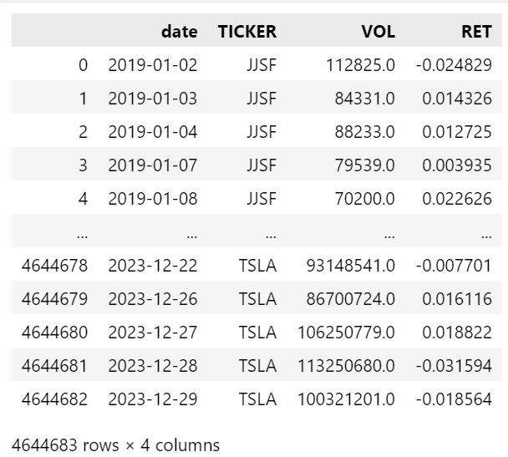
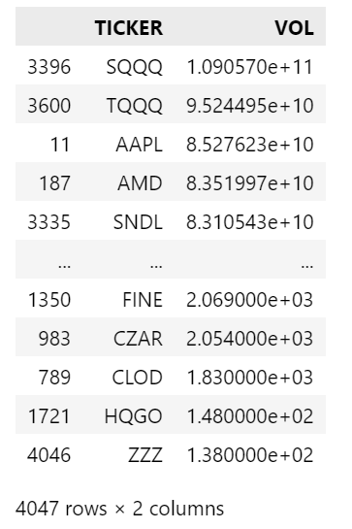
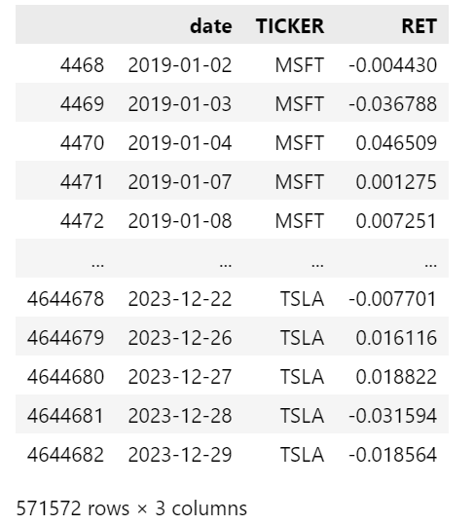
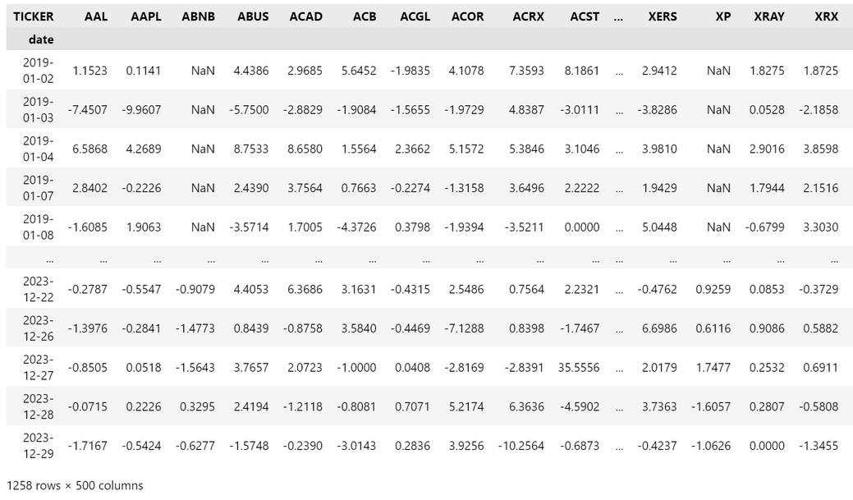
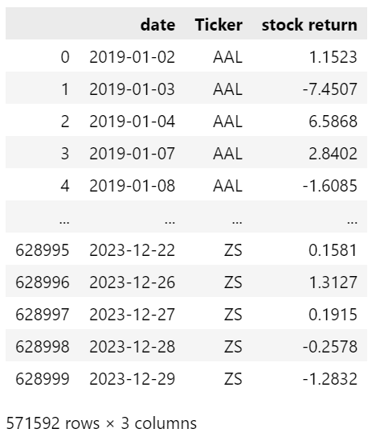
Top 500 volume ticker
Select the returns
Data processing
Long table
(for data integration)

Slide 5
2. Data
2.2 Factors
Moving Averages
Fundamental
Overlap
Market Factors
Volume
Momentum
Volatility

Slide 6
2. Data
2.2 Factors
Factor Type | Amount | Main Factors
Market | 5 | Mkt-RF, SMB, HML, RMW, CMA
Fundamental | 33 | AbsAccrual, DIV_P, TaxExp, CURRENT, FCF_P, CEQG, momaccel……
Moving Average | 11 | SMA_5, SMA_10, SMA_30, WMA_5, WMA_10, WMA_30, TEMA_5, TMEA_10, TMEA_30, MAMA, FAMA
Overlap | 10 | BBANDS_upper, BBANDS_up, HTITREND, SAR, SAR_norm……
Momentum | 24 | MACD, STOCH, WILLR, CMO, MFI ……
Volume | 5 | Chaikin A/D Line, Chaikin A/D Oscillator , On Balance Volume, Volume-Price Trend, Volume Weighted Adjusted Price
Volatility | 3 | ATR, ATR_normalized, NATR

Slide 7
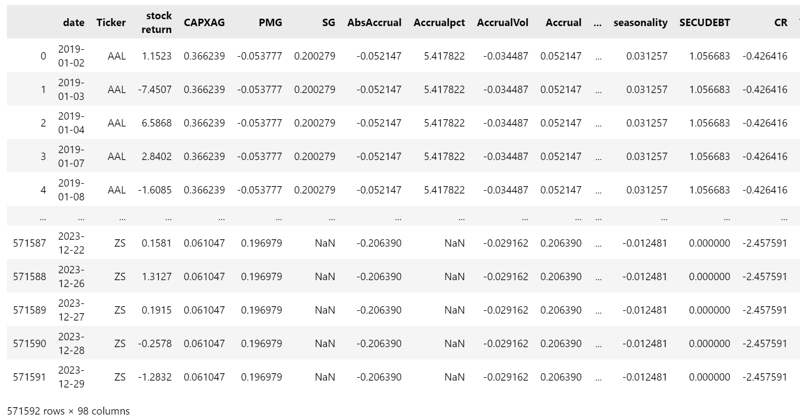
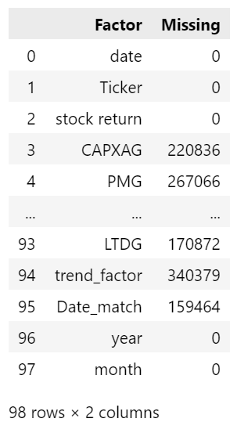
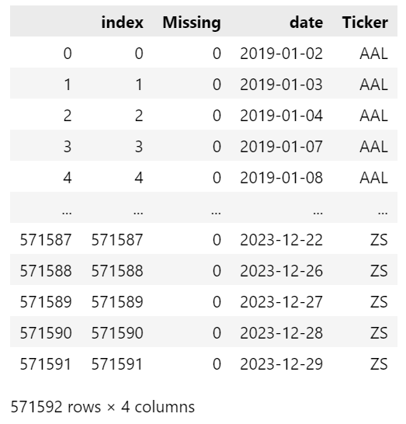
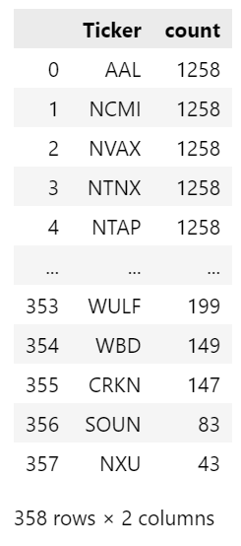
Data source: Data
Market factor: Ken French’s website
fundamental factors: Wharton Research Data Service / Factors by WRDS
Trading related data: CRSP / Annual Update / Stock - Version 2 (CIZ) /Daily Stock File
Data integration
Data processing
Time (return) | Time (market factor) | Time(fundamental factor) | Time(trading related factor)
t | t | Last day(t-1) | Last month
Missing data
(each factor)
Missing data
(each ticker & date)

Slide 8

Where excess return come from？
Excess return
Explain more about some facts related to the melting of arctic ice here
Market factors
Characteristics of stock itself
Fama-French 5 factor model
Alpha generation model

Slide 9
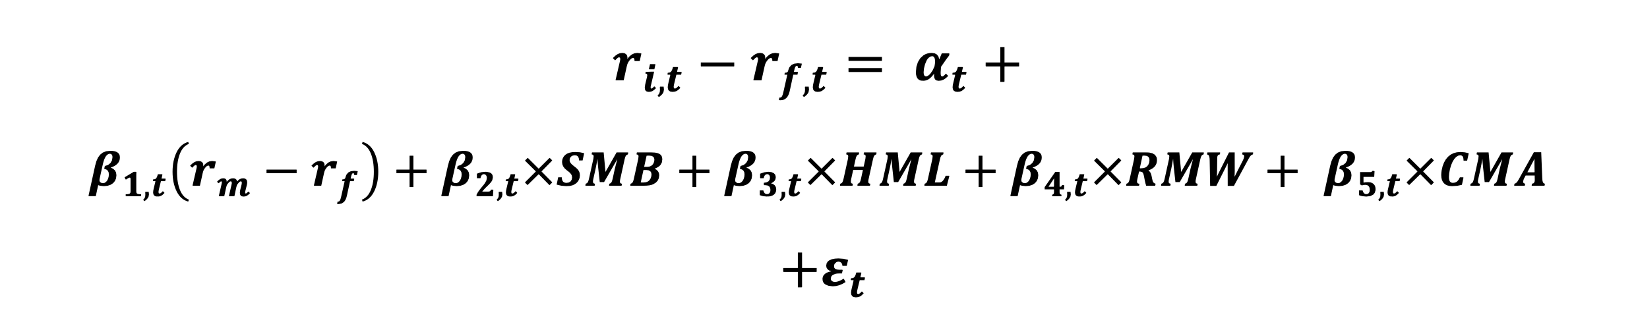
What is alpha？
$$r_{i,t}−r_{f,t}= α_{t}+$$
$$β_{1,t}\left(r_{m}−r_{f}\right)+β_{2,t}×SMB+β_{3,t}×HML+β_{4,t}×RMW+ β_{5,t}×CMA$$
$$+ε_{t}$$
cannot be explained by market
Market influence
Rolling OLS (rolling window = 30) to calculate alpha for every ticker

Slide 10
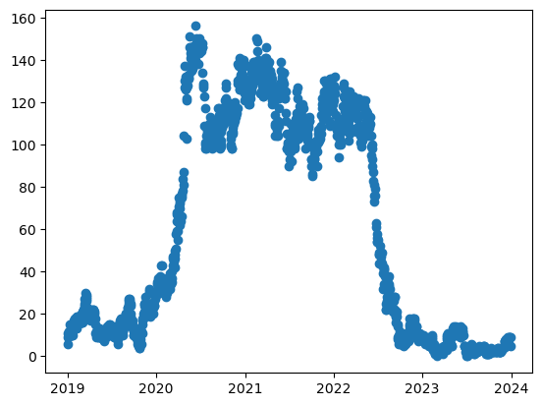
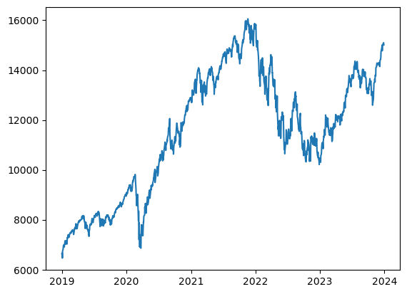
statistical analysis of alpha
number of positive alphas each day
number of positive alphas for each ticker
Ticker | positive alpha count | mean | std
ENPH | 702 | -0.30026 | 1.236383
VTGN | 558 | -0.24116 | 2.6429
MVIS | 535 | -0.2922 | 1.845128
MNKD | 526 | -0.46201 | 1.150493
NVAX | 526 | -0.50804 | 1.902888
MARA | 515 | -0.47466 | 1.649636
TSLA | 512 | -0.48082 | 0.984606
ALT | 506 | -0.21931 | 2.451346
CPRX | 505 | -0.51581 | 1.026406
CRIS | 504 | -0.53011 | 1.815152
VTNR | 496 | -0.32805 | 1.86968
CROX | 494 | -0.496 | 0.895479
TGTX | 488 | -0.50076 | 1.071262
SLS | 484 | -0.76836 | 1.803954
BCRX | 480 | -0.60646 | 1.204831
OTLK | 471 | -0.66838 | 3.281197
CODX | 466 | -0.50705 | 1.7427
ETSY | 460 | -0.5363 | 0.94039
FATE | 459 | -0.68074 | 1.190794
RUN | 459 | -0.54431 | 1.123254
Adj-close price of NASDAQ composite

Slide 11

Model Selection
Model | Type | Mean MSE | Running time (second)
ElasticNet | Linear | 1.9827 | 71s
Lasso | Linear | 2.0189 | 18.5s
Ridge | Linear | 1.6758 | 1.6s
Huber Regressor | Linear | 2.1682 | 22.5s
RANSAC Regressor | Linear | 12.7320 | 20.2s
LightGBM | Boost | 0.9487 | 24.7s
XGBoost | Boost | 1.1118 | 324.6s
CatBoost | Boost | 0.9628 | 250.9s
KNeighbors Regressor | KNN | 2.6225 | 124.8s

Slide 12
Adjust Parameters
Parameter searching : GridSearchCV
Cross validation : TimeSeriesSplit
Model | Parameter | Mean MSE Before | Mean MSE After
ElasticNet | {'alpha':0.01, ‘ll_ratio': 0.1} | 1.9827 | 1.7406
Ridge | {'alpha': 10, 'Max_iter': 500} | 1.6758 | 1.6757
LightGBM | {'learning_rate': 0.1, 'max_depth': 3, 'num_leaves': 30} | 0.9487 | 0.9166
CatBoost | {'depth': 7, ’ iterations': 1500, 'learning_rate': 0.01} | 0.9628 | 0.8676

Slide 13

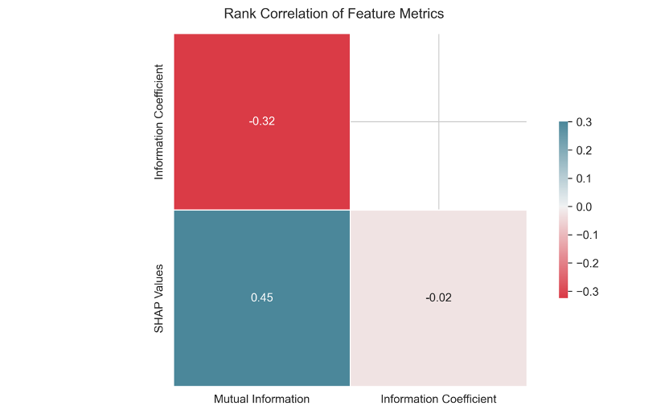
Basic Factors Analysis
The correlation between SHAP value and Mutual Information is high
The correlation between Mutual Information and Information Coefficient is negative
There is almost no correlation between the SHAP values and the information coefficients
www.reallygreatsite.com

Slide 14
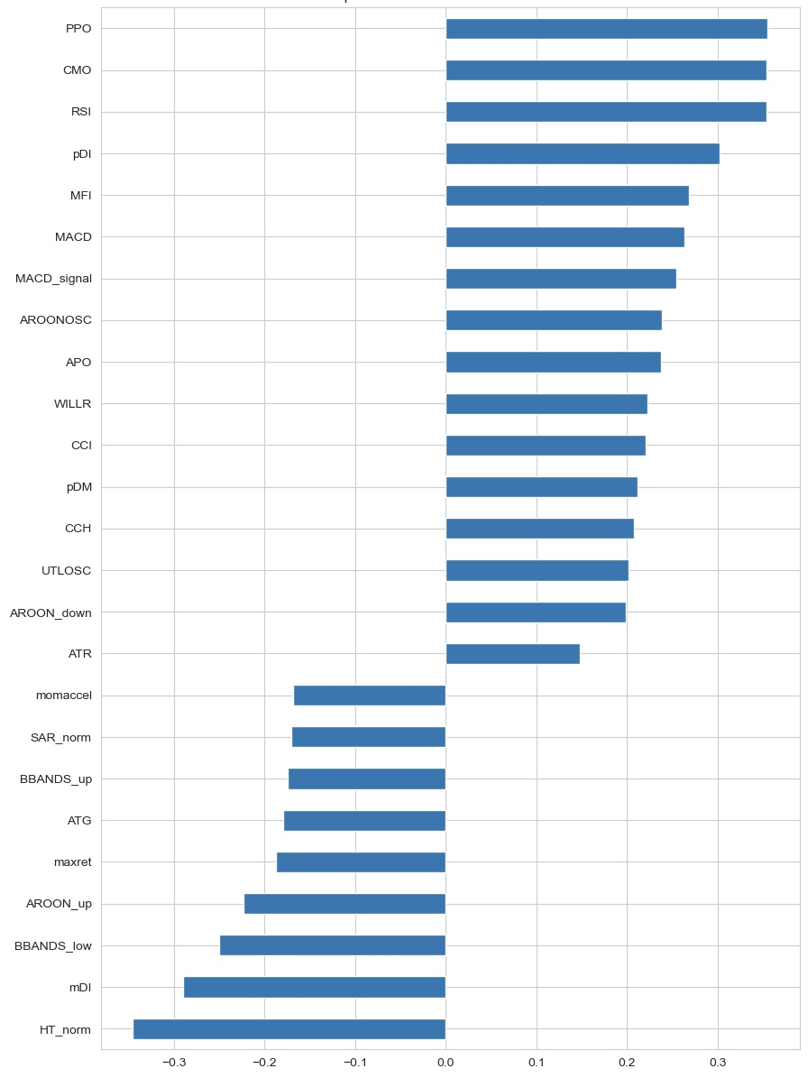
Top 25 factors correlation with return
Positively correlated factors: PPO, CMO, RSI, pDI, MFI,MACD, MACD_signal, AROONOSC, APO, WILLR, CCI, pDM, CCH, UTLOSC, ATR AROON_down
Negative correlated factors: momaccel, SAR_norm, BBANDS_up,ATG, maxret, AROON_up, BBANDS_low ,mDI, HT_norm

Slide 15
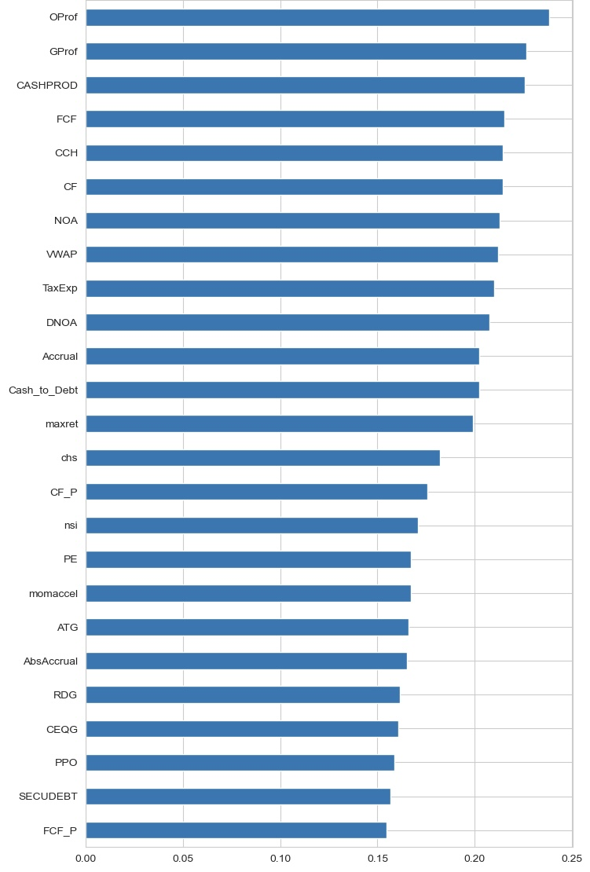
Top 25 factors mutual information with return

Slide 16
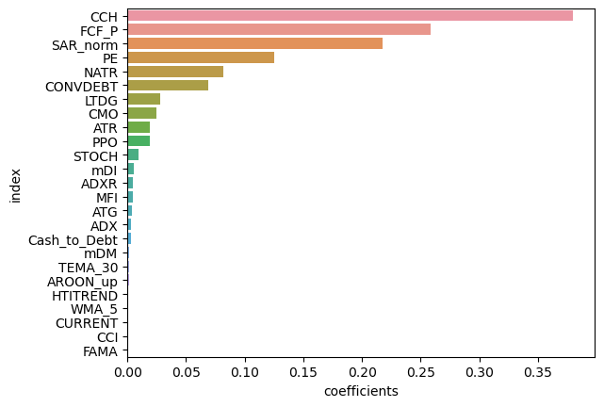
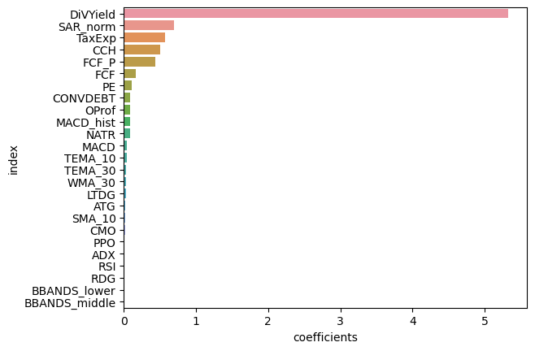
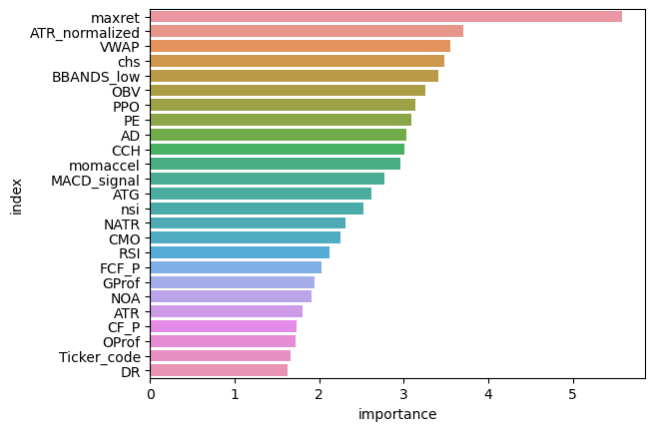
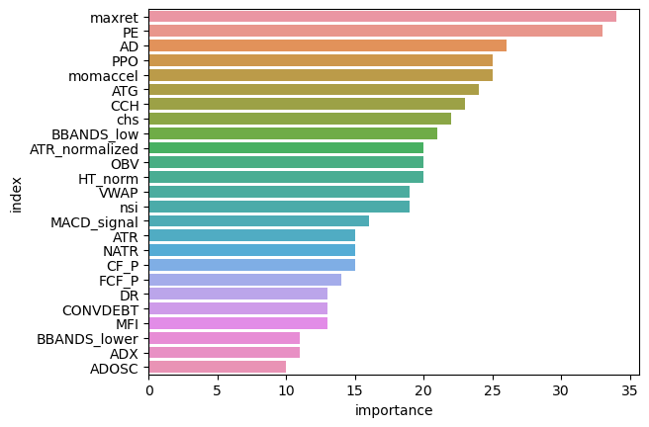
The relationship between alpha and factors in 4 models
Elastic Net
Ridge
LightGBM
Catboost

Slide 17

THANK YOU!
www.reallygreatsite.com

